Slide 1
应用统计与深度学习实验课
高婷
2021年9月23日

Slide 2
Recap
Numpy vs Pandas , Visualization
Numpy vs Tensor
Autograd
Example: Implementation from scratch v.s. concise
Linear Regression
Multi-class classification (Lesson1.3.ipynb)

Slide 3
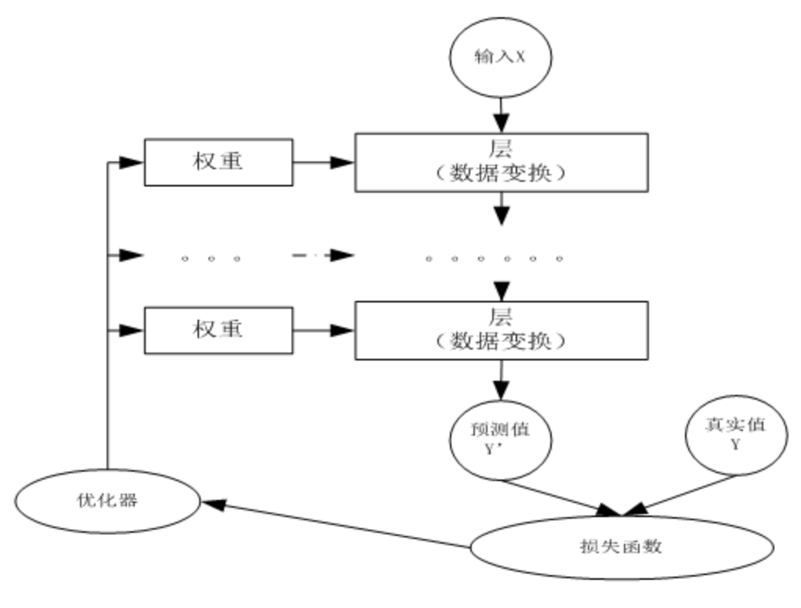
Recap

Slide 4
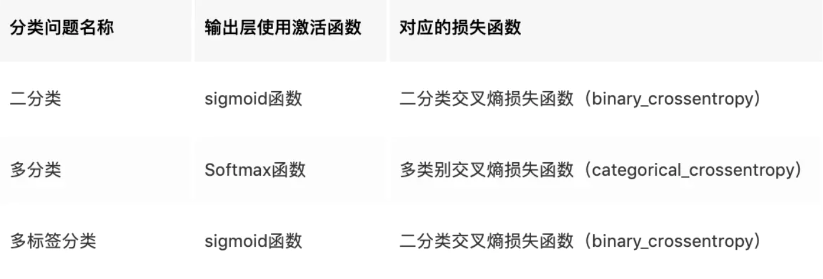
Classification Problems

Slide 5
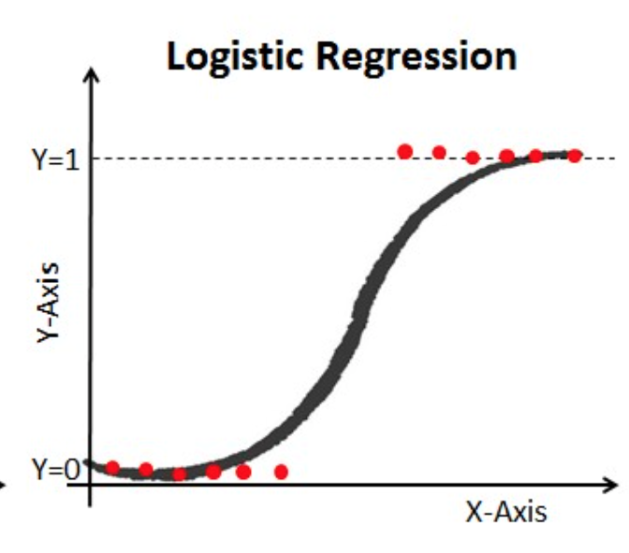
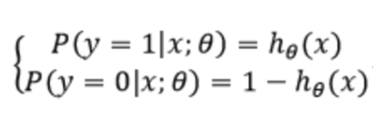
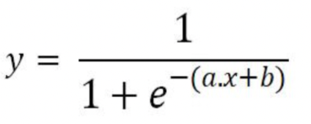
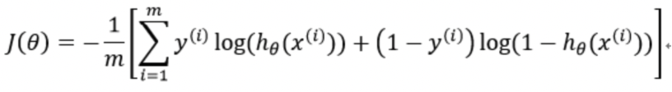
Logistic Regression
Solve: a, b = ?
Cross Entropy Loss

Slide 6
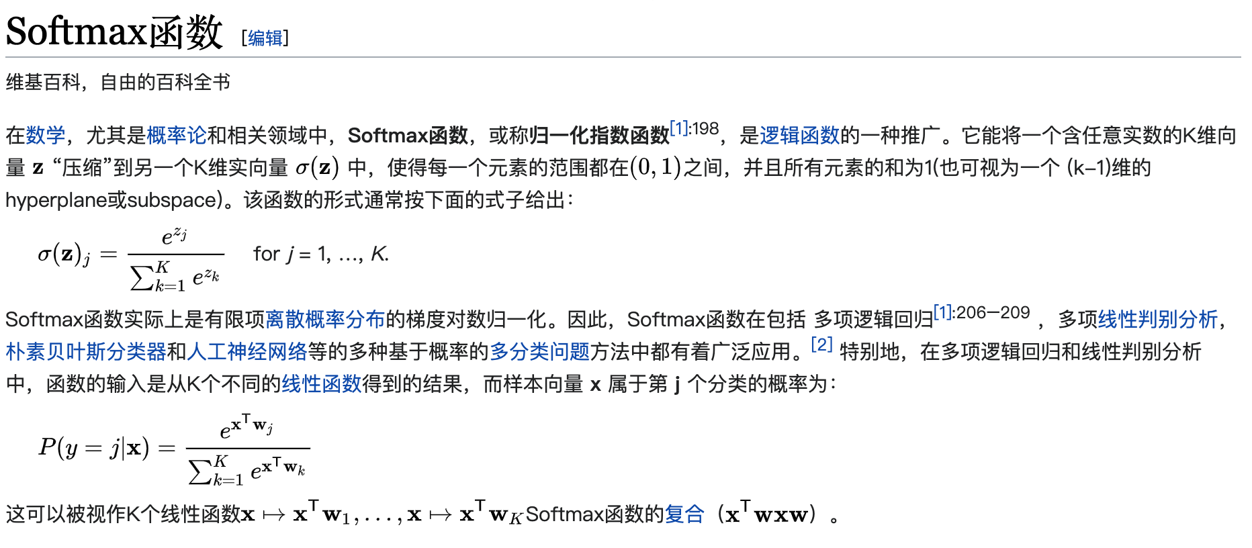
Multi-class Classification

Slide 7
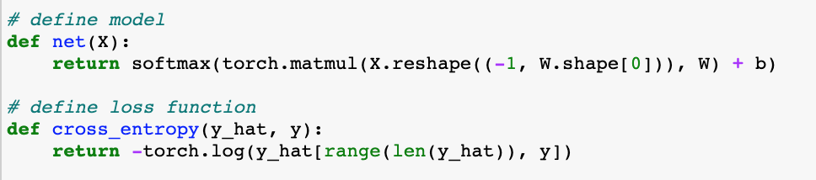
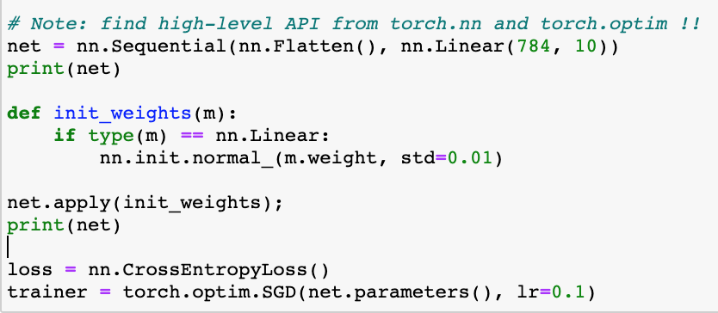
V.S.

Slide 8
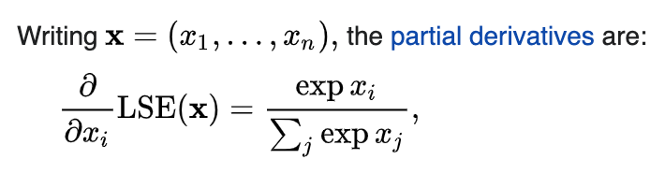
LogSumExp
The LogSumExp(LSE) is also called multivariable softplus function that is a smooth approximation to the maximum function, mainly used by ML algorithms. LSE is convex and strictly increasing everywhere in its domain but not strictly convex everywhere.

Slide 9
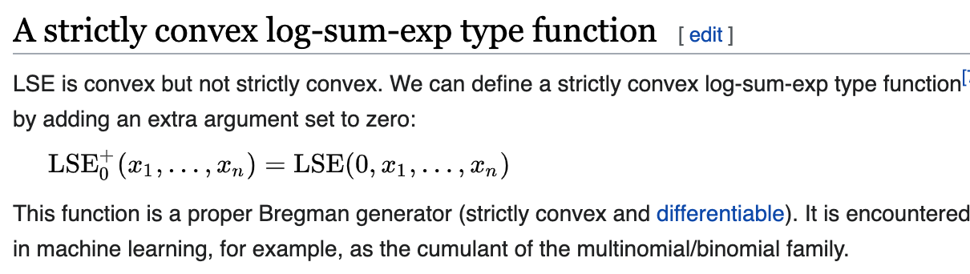

Slide 10
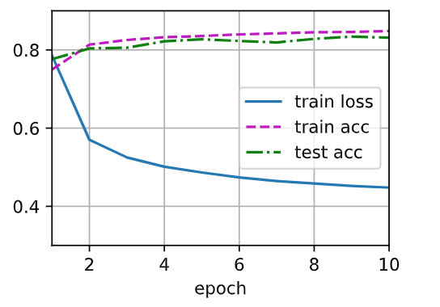
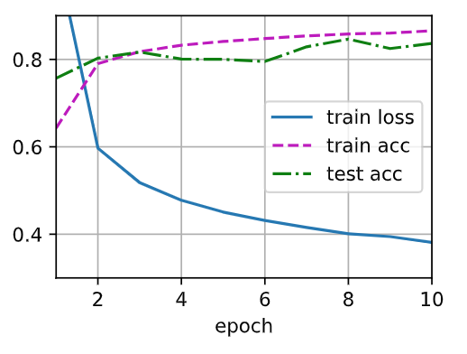
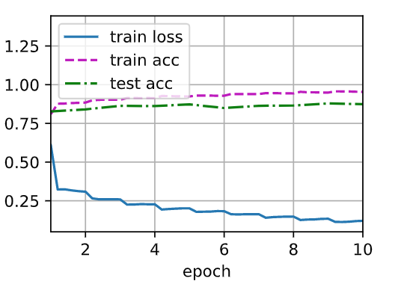
Goals for the next:
MLP and how to customize its components. (Lesson 2.1.ipynb)
Modern techniques and models: CNN/ ResNet (Lesson 2.2.ipynb)
Model training pipeline and tensorboard practice. (Lesson 2.3.ipynb)

Slide 11
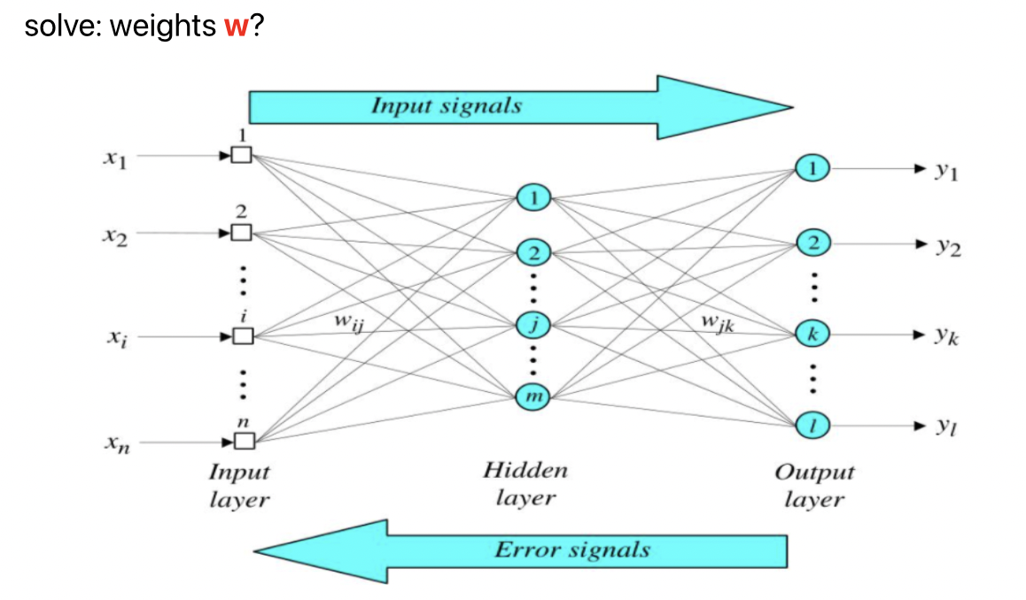
MLP (Multi-Layer Perceptron)

Slide 12
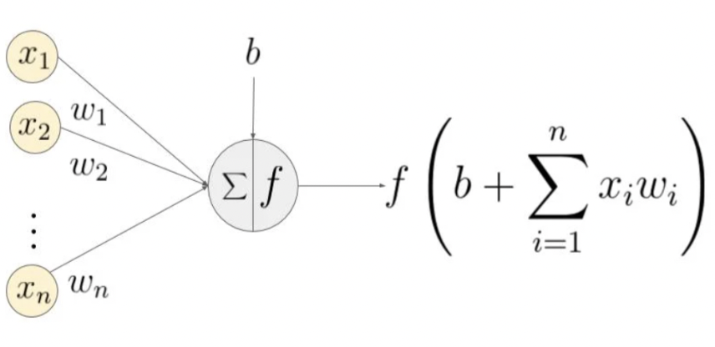
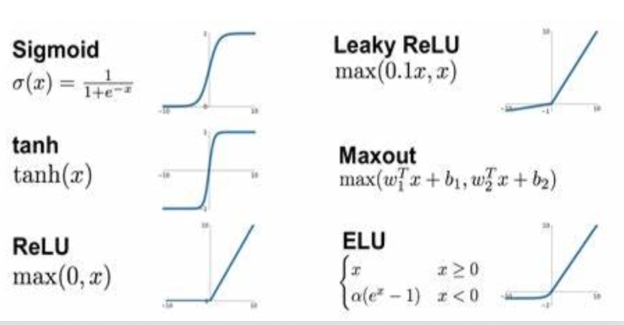
MLP (Multi-Layer Perceptron)
f: activation function

